Slide 1

Nature-Intelligent Legal Services:
The IBA Series in Action
13 October 2026

Slide 2

Speakers:
Jenni Ramos – Lead author/creator of the IBA's Nature-Intelligent Legal Services Toolkit,
Corporate and Nature Lawyer
Wangui Kaniaru – Partner at ALN Kenya;
Co-Chair, IBA Law Firm Management Committee ESG Sub-Committee;
Named Expert Adviser, Oxford Net Zero Policy Monitor;
Co-Chair, Climate Research Forum Loss & Damage Working Group, Oxford Sustainable Law Programme;
Lead Reviewer, Oxford University Climate Policy Hub (Kenya & Rwanda)

Slide 3
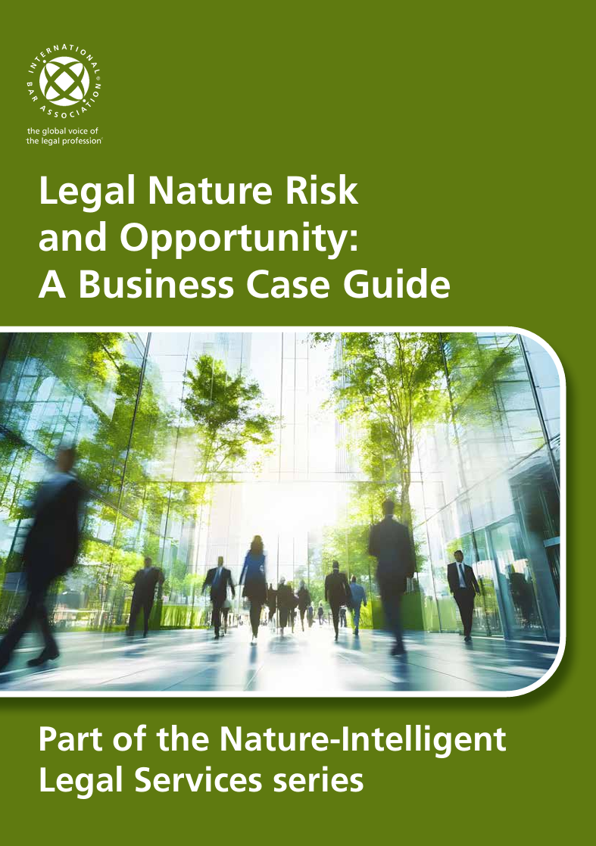
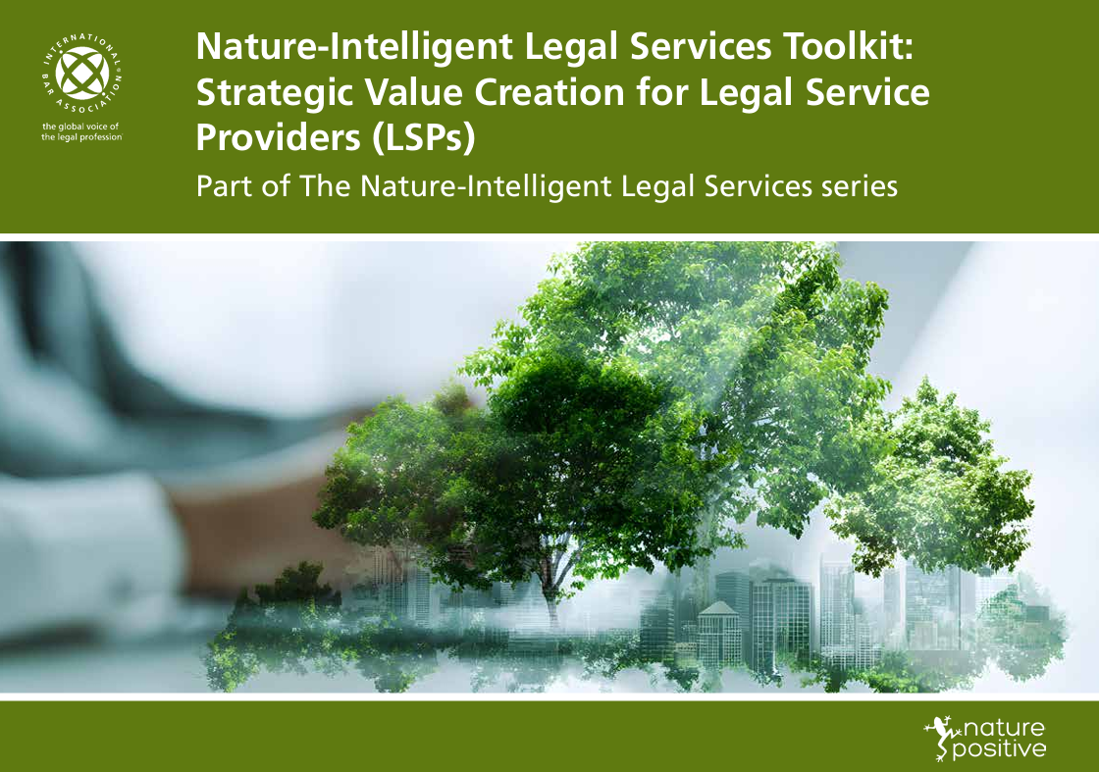
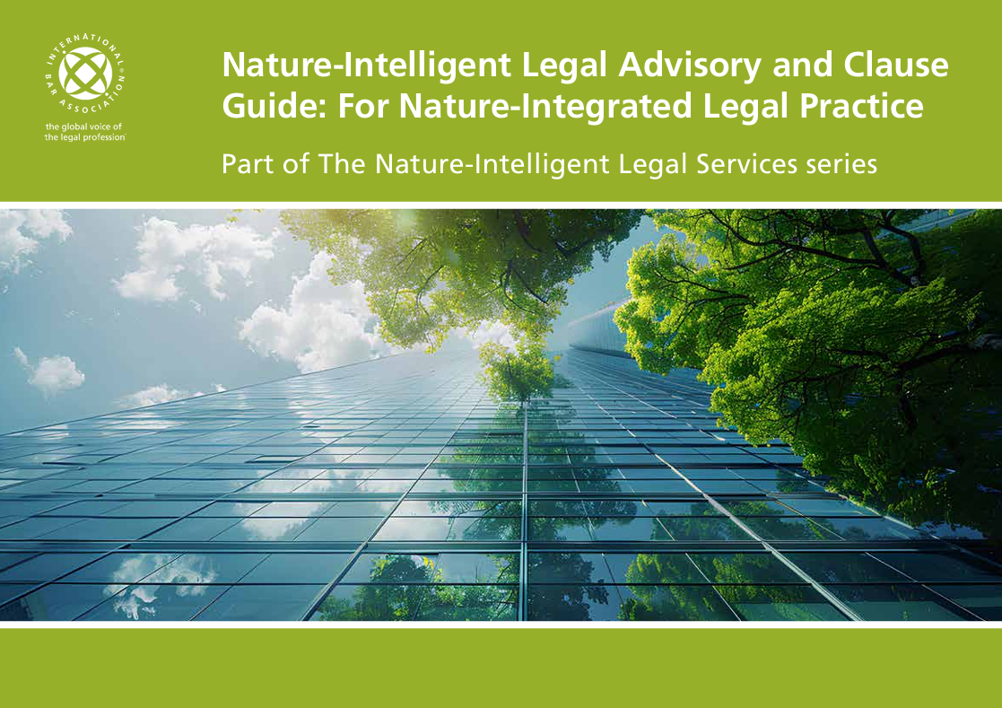
Nature-Intelligent Legal Services:
The IBA Series in Action
Jenni Ramos - lead author
Notes:
The Nature-Intelligent Legal Services series has three parts. A Business Case Guide, the main Toolkit for client assessment and The Legal Advisory and Clause Guide.
The series is content heavy, but designed to allow users to jump to different sections, not necessarily reading cover to cover, so please don’t let the amount of information dissuade you from jumping in!
We’ll look in more detail at each part of the series, but before we do, why did we create this series?

Slide 4
Every Lawyer is a Nature-Lawyer
Nature literacy is fundamental to understanding clients’ business context.
Key professional competency.
Applicable to all practice areas - not only environmental law.
Simple, practical tools to confidently upskill and provide strategic nature-intelligent advice within core work.
A business development, risk mitigation and strategy resource.
Law firm governance gap.
VISION
As trusted advisers, legal service providers become a source of expertise that clients turn to for navigating the nature positive transition – creating competitive advantage while advancing nature outcomes across the economy.
Notes:
Lawyers have always needed commercial and financial awareness to understand their clients' business context.
Nature literacy is fundamental to that professional competency, but many lawyers see it as niche or overwhelming. It is not yet properly understood in business terms.
Clients increasingly expect their advisors to demonstrate governance maturity in areas where they provide counsel. Legal service providers gain credibility through visible commitment to the standards they recommend to clients. Without internal nature governance systems, firms expose themselves to talent attrition and missed revenue opportunities.
This series translates complex nature frameworks into practical tools, enabling lawyers from any practice area to engage confidently as strategic advisors on nature-related risks within their core work.
It can be used to maximise opportunity - for example client demand, talent attraction and new revenue and to anticipate and mitigate risk - for example client loss, reputational exposure and avoidable compliance costs.

Slide 5

Who can use this series?
Leadership teams - to support governance and oversight, firm-level strategic targets and implementation plans, performance linked metrics and capacity building.
Sustainability professionals and lawyers - to help advise leadership teams on the relevance of nature
Client onboarding teams - to estimate clients’ sectoral nature indicators (how much the client’s sector typically depends on and impacts nature) and evaluate clients’ nature governance stage.
Lawyers working with business development teams - to identify opportunities for embedding nature considerations in legal services and adding value to clients.
Leadership, sustainability and business development teams - to develop a strategic dashboard to prioritise client engagement and understand the overall client portfolio risks and opportunities.
Notes:
The series is designed so that a range of professionals from different parts of a firm can jump in and use parts of it, either on their own, as teams or working with other parts of the firm

Slide 6
Part 1: The Business Case Guide
Impacts and dependencies on nature lead to risks for organisations and their value chains.
Clients’ nature exposure is part of a law firm’s value chain.
Opportunities for lawyers to manage these risks = new clients, matters and markets.
Current legal industry not awake to mainstream relevance of nature - seen as niche.
Use this guide to signpost colleagues and law firm management.
Over half of global GDP (US$58 trillion) is moderately or highly dependent on ecosystem services.
World Economic Forum / PwC
Notes:
Securing senior leadership commitment requires framing nature as a strategic business issue, not a compliance exercise.
Most lawyers do not see nature as relevant to their main practice, it is seen as a compliance or environment law niche.
This is why the business case guide precedes the main toolkit. It can be used with colleagues and leadership teams who are not yet persuaded.
Client nature exposure is part of a law firm’s value chain.
No part of the economy is insulated from nature-related financial risks.
However, where there is risk there is opportunity, and this is what this series focuses on.

Slide 7
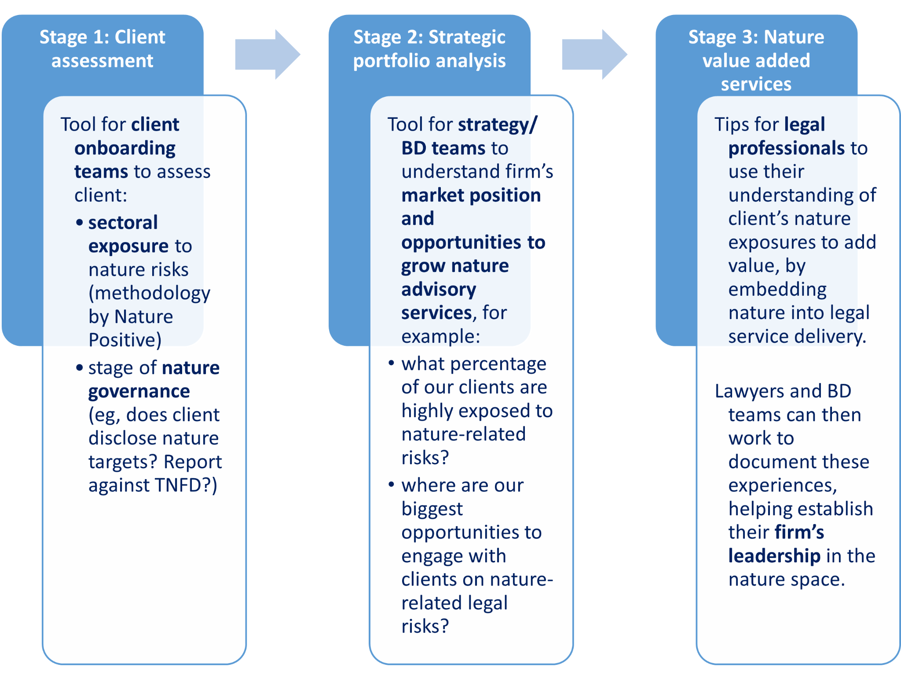
Part 2: The Toolkit
Modular design: use all or part of the tool, from any starting point.
Notes:
The toolkit in part 2 of the series is designed so that parts of it can be adopted by individuals, teams and firms as applicable to their resources, to reduce barriers to entry.
The introductory section of the toolkit signposts readers to the parts most useful to them.
There are three stages:
Stage 1: client assessment of sectoral nature exposure and nature governance;
Stage 2: how to use the stage 1 information for strategic portfolio analysis; and
Stage 3: Nature value added services, linking to the advisory and clause guide.
Let’s look a little closer at each stage

Slide 8
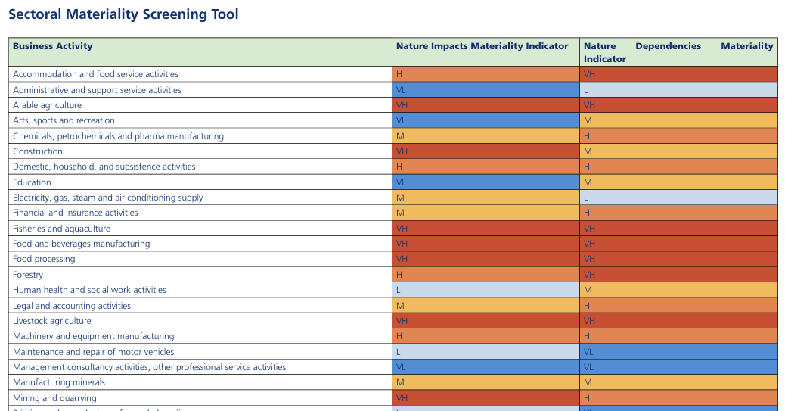
Toolkit Stage 1a: Client’s sectoral nature indicators
Notes:
Stage 1a of the toolkit gives lawyers a high level overview of the likely exposure of their client to nature related impacts and dependencies, based on estimated materiality scorings for that sector - ranging from Very low through to very high.
It is important to note that these sectoral scores are deliberately high-level proxy indicators based on industry-level data. They are not precise assessments of individual client impacts or dependencies.
They are designed to enable quick identification of which clients are potentially exposed to high nature-related risks and opportunities, allowing firms to categorise their client portfolio by estimated proxy nature impacts and dependencies.
The data for the indicators was taken from the Exploring Natural Capital Opportunities, Risks and Exposure database (ENCORE). ENCORE's materiality ratings indicate a typical level of materiality at global level, and this data has been further aggregated to produce approximate ratings. The actual materiality of dependencies and impacts is likely to vary significantly based on the specific context, company and location.

Slide 9
Toolkit Stage 1b: Client’s nature governance
Pre-alignment (Limited response) | No public disclosure of nature-related risks, impacts, or commitments.
Starter (Acknowledgement and initial transparency) | Undertakes some voluntary CDP nature reporting.
Foundation (Financial risk management) | Voluntary TNFD reporting on nature-related financial risks.
Impact (Impact identification and action) | Publicly disclosed nature-related impacts and science-based targets for nature.
Strategist (Full business integration and ambition) | Targets integrated into governance and strategy, regular progress reporting.
Leader (Full transparency and advocacy) | Full outcome reporting, transparency on lobbying and advocacy.
Notes:
Stage 1b of the toolkit allows lawyers to categorise where clients are on their nature governance journey - from Pre-alignment, where there's no public disclosure at all, through various stages of disclosure, reporting, target setting and strategy indication, through to Leaders who have full disclosure of nature impacts and dependencies, outcome reporting on targets, transition planning and transparency on lobbying.
This isn't about judging clients, but about understanding where they are so you can support them appropriately and identify where governance gaps might create risk.
Once you have that client-level picture, Stage 2 zooms out to the full client portfolio.

Slide 10
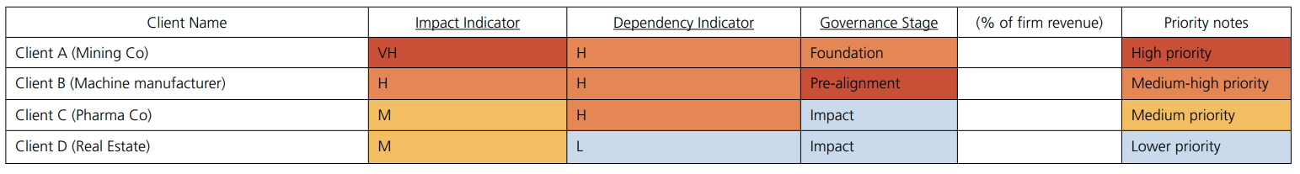
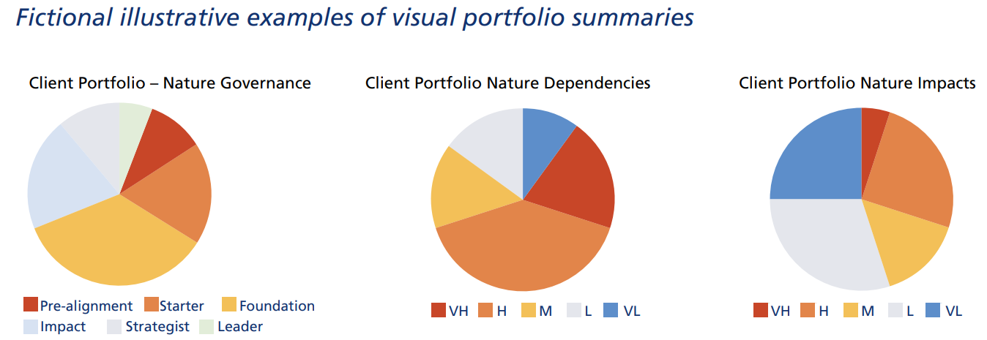
Toolkit Stage 2: Strategic portfolio analysis
Notes:
Stage 2 of the toolkit suggests how firms might use the data from Stage 1.
This gives you a visual of where your client base sits in terms of their nature impacts and dependencies and how far they have progressed in governing them. Firms can combine this with internal data like revenue percentage. This enables quick analysis of which clients need immediate attention, where opportunities lie, and how your firm's overall risk exposure is distributed.

Slide 11
Toolkit Stage 3: ‘Nature Value Add’ - embedding nature
in legal services
Starting the nature conversation:
’We’re seeing [X nature risks] emerging as material concerns in your sector – we can help you address them through governance and contracts.’
‘New nature regulations may require [X] – we’re ready to assist with compliance strategies when you need them.’
‘Many organisations are exploring legal operationalisation of sustainability commitments – we’re well-placed to support this.’
‘Material nature-related risks can be relevant to directors’ duties of care and to promote company success – we can advise on how you might navigate these risks.’
Links the Toolkit with the accompanying Legal Advisory & Clause Guide.
Business development possibilities:
Record number of matters where Nature Value Add was provided, their associated value or revenue.
Record impact of Nature Value Add (e.g. positive client feedback).
Notes:
Stage 3 of the toolkit shows firms how to use the client data from Stages 1 and 2 to start meaningful conversations with clients.
It provides example prompts to help lawyers raise nature topics naturally - whether that's flagging emerging sectoral risks, new regulations, or how directors' duties intersect with nature considerations.
It also shows how firms can track Nature Value Add - i.e. the value they deliver to clients when using the Advisory & Clause Guide - recording both revenue impact and client feedback for business development purposes.

Slide 12
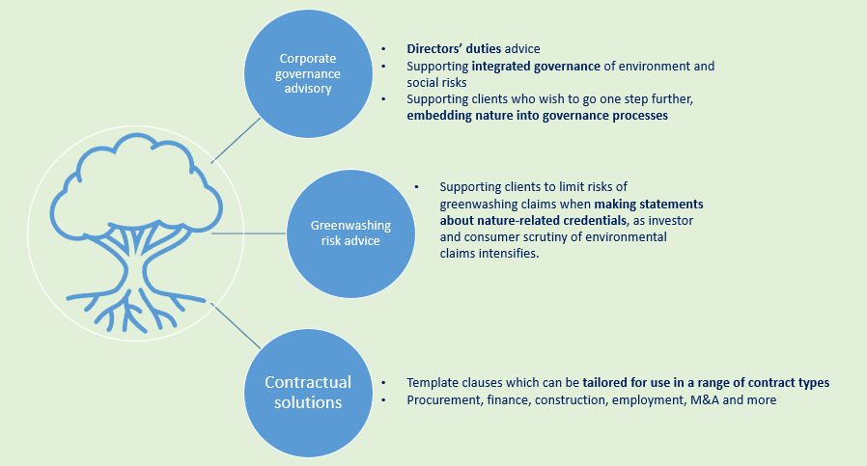
Part 3: The Legal Advisory and Clause Guide
Illustrative case studies show how legal advice & contracts can help clients address a range of nature-related risks & opportunities across sectors, from agricultural products, finance, energy, mining, textiles, real estate and more.
Notes:
So, turning to the advisory and clause guide, this final part of the series provides a practical guide for lawyers to use their knowledge of a client’s nature-related risk exposure to add value through legal advice. Ideally it will be informed by the data gathered in the toolkit but it can be used as a stand alone guide for firms that haven’t yet implemented the toolkit
This is not an exhaustive guide but aims to demonstrate starting points to inspire lawyers to incorporate nature considerations into corporate governance advice, greenwashing advice and a variety of contractual clauses across sectors, from procurement contracts to financial agreements, construction contracts, employment agreements and more.

Slide 13
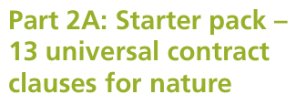
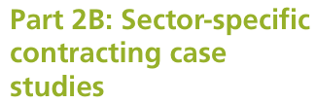
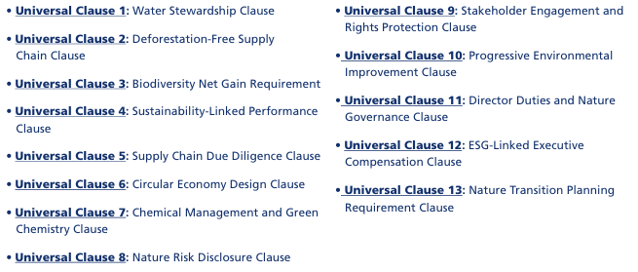
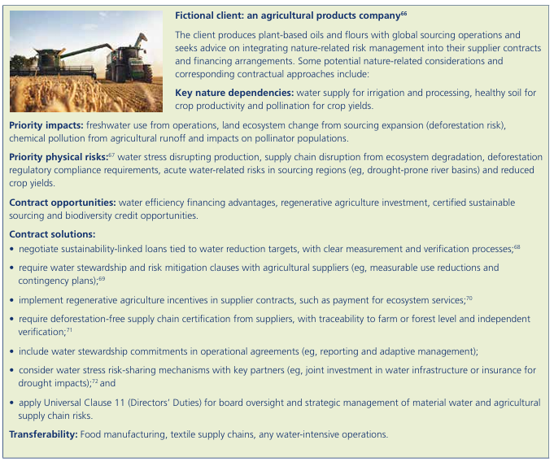
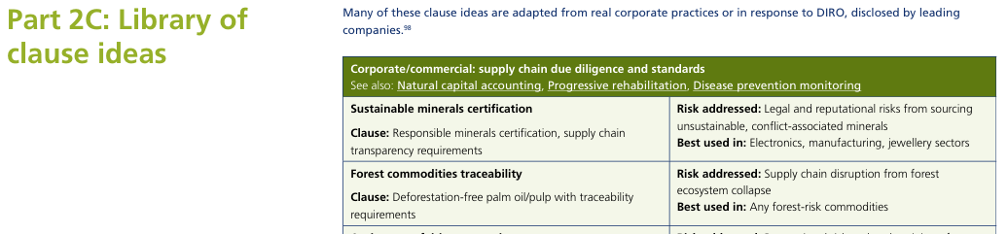
Nature-intelligent Contracting
Notes:
In terms of clauses, the guide has universal clauses that can be used across a variety of contracts, a series of illustrative case studies to show how contracting solutions can work in practice, inspired by companies’ real TNFD reports. It finishes with a clause library of further clause ideas.

Slide 14
Barriers?
Poll: What barriers might deter you or your colleagues from using the series?
“My clients aren’t asking for it”
“I worry about overstepping my professional role”
“It’s a lot to take in / I don’t know where to start”
“I don’t have time”
“Not sure it’s relevant to my practice area”
“Hard to justify commercially / can’t bill for it”
“Lack of support from my firm or leadership”
Other concerns - please feel free to share in the chat…
Notes:
So in summary, the three parts of the series give legal professionals everything they need to move from awareness to action - understanding their clients' nature exposure, identifying where to focus, and knowing how to embed nature considerations into the advice and contracts they're already delivering.
However, the series is ambitious and we recognise there are barriers to entry. It would be great to hear from you what you think the barriers are, so please use the poll to share your thoughts..

Slide 15
Is the Market Already Telling Us Something?
CASE STUDY – ELM GROVE RISK ADVISERS LIMITED
Using the IBA Nature-Intelligent Legal Services Toolkit for portfolio analysis and business development
Real market signal. Fictional firm and clients. October 2026.
Notes:
This deck walks one live market signal, the August 2026 spike in corporate mentions of El Nino, through the Toolkit's Stage 1a, Stage 1b, Annex 4, Stage 2a and Stage 2b. Each Toolkit extract is followed by its application to a fictional firm.

Slide 16
Corporate concern over El Niño is at its highest since 2019
THE SIGNAL
478
1,443
316
companies mentioned El Niño in filings and calls, 1 May to 4 August 2026
documents carried those mentions
mentions on earnings calls, the most since 2019
The exposure companies describe is often indirect: delayed planting shifting demand, and rural sales at risk if farm incomes fall. The mentions cluster in Asia-Pacific and Latin America.
Source: Reuters, 14 August 2026, citing AlphaSense data. Link - https://www.reuters.com/legal/litigation/corporate-concern-over-el-nino-hits-multi-year-high-2026-08-14/
Notes:
El Nino is a climate event, but the losses run through nature dependencies: water availability, crop productivity, flood protection. Those are the ecosystem services the Toolkit's dependency indicators measure. An earnings-call spike is a moment when clients name the exposure themselves, in front of investors.

Slide 17
What an earnings-call spike cannot tell you
LIMITS OF THE SIGNAL
Attention is not materiality
The cycle passes, the dependency stays
Mention counts measure what companies talk about. A silent client may be more exposed than a vocal one.
El Niño reveals nature dependencies. It is not itself evidence of nature loss, and attention will fade with it.
Listed companies only
Location decides the hazard
Transcript data does not cover private clients or public bodies. For them the Stage 1 proxy stands alone.
Whether El Niño means drought or flood depends on where the client operates.
Notes:
These limits are why the signal is an added column on the Toolkit dashboard and not a replacement for it. The Toolkit's sector scores and governance stages remain the base; the signal helps with timing and with testing the proxy.

Slide 18
How long-tail effects reach European businesses
THE SIGNAL, CLOSER TO HOME
Agricultural supply
Logistics
Ivorian cocoa forecast at 1.35 to 1.45 Mt against a 1.6 Mt baseline. French grain maize at 9.0 Mt, the lowest since 1980.
The Rhine at Kaub fell to 14 cm on 11 August 2026, the lowest since records began in 1880. Panama Canal draft is restricted.
Energy and industrial inputs
Critical minerals
Lower hydropower output in Latin America and stronger competition for LNG cargoes.
Flooding and drought disrupting mining and processing operations.
Source: EY Netherlands, 5 October 2026. Link - https://www.ey.com/en_nl/insights/resilience/what-a-record-el-nino-could-potentially-mean-for-european-businesses
Notes:
The Reuters data skews to Asia-Pacific and Latin America, with India prominent. The EY analysis shows why that is still a European and African story: the exposure travels through commodities, river and canal logistics, energy and minerals. EY also reports a 10.7% year-on-year fall in EU grain maize, a 26% forecast drop in Australian wheat and Indian export restrictions on sugar and rice. Each channel is a nature dependency: water flow, rainfall, soil productivity. EY's three questions for leadership: which strategy assumptions depend on stable commodity prices; where do diversified operations depend on the same regions, infrastructure and commodities; and where would disruption hit first, revenue, margin or balance sheet.

Slide 19
Six areas of business value from science-based targets for nature
WHY COMPANIES ACT
Protected revenue and market access
Lower cost of credibility
Better decisions, more focused resources
Independent validation supports evidence-based claims and reduces reputational risk.
Protecting sourcing continuity and responding to emerging requirements.
Sharper prioritisation of resources and management attention.
Greater confidence in what action is needed
A common framework for ownership
Future-proofing how nature is managed
Clarity on whether current activity is enough, or where more is needed.
A shared basis for ownership, coordination and action across the business.
Capabilities that support evolving regulatory, market and financing expectations.
Source: Accountability Accelerator, EBP and SBTN, The Business Case for Science-Based Targets (Step Up for Nature), September 2026.
Notes:
Drawn from interviews with companies applying the SBTN framework, including Arla Foods, GSK, H&M Group, Holcim, John Lewis Partnership, Kering, Kirin Holdings, KLS Pureprint, Musholm, Orkla Foods Sverige, Orsted, Seatopia, Talawakelle Tea Estates and Tata Motors. Companies described science-based targets for nature as a practical way to bring clarity and rigour to a complex issue: better decisions, stronger credibility, more resilience. For the breakout these six areas are the client's language for why to act; each one is also a legal workstream, from supply contracts to claims substantiation to board governance.

Slide 20
Fewer than half of CDP disclosers report on biodiversity or water
WHAT COMPANIES DISCLOSE
Corporate disclosures by theme, 2025
By country, 2025
Total disclosing
22,165
Germany
1,626
Climate change
22,165
UK
1,463
Biodiversity
9,935
Brazil
1,251
Water security
9,922
Italy
682
Plastics
4,262
France
557
Forests
3,828
Source: CDP Fact Sheet, 2025. Number of corporate disclosures. Link - https://www.cdp.net/en/insights/keeping-pace-disclosure-data-factsheet-2025
Notes:
Every one of the 22,165 disclosing companies reported on climate change. Only 9,935 (about 45%) reported on biodiversity and 9,922 (about 45%) on water security; plastics 4,262 (about 19%) and forests 3,828 (about 17%). The gap between climate and nature reporting is the perception gap the Business Case Guide describes, and it is where an El Nino conversation can start: the client already reports climate risk, and water is the next step. The country figures are as supplied; the selection of countries is from the source document.

Slide 21
Over half of domestic value is highly exposed to nature loss in every top CDP country
EXPOSURE AT COUNTRY LEVEL
Italy
Domestic
61% · €1.0tn
Score 56 · 682 CDP
Imported
28% · €75bn
Germany
Domestic
54% · €1.8tn
Score 51 · 1,626 CDP
Imported
36% · €226bn
France
Domestic
54% · €1.2tn
Score 49 · 557 CDP
Imported
13% · €39bn
UK
Domestic
51% · €1.2tn
Score 47 · 1,463 CDP
Imported
10% · €25bn
Country exposure score: ENCORE's measure of a national economy's dependency on nature, based on how much of its economic output is highly dependent on ecosystem services.
Imported exposure varies far more, from 10% in the UK to 36% in Germany: the risk arrives through supply chains.
Share of value highly exposed to nature loss. Sources: ENCORE Insights country profiles (21 May 2026), euros as published; CDP Fact Sheet 2025 (disclosures).
Notes:
Each country shows two bars on the same 0 to 100% scale: the share of domestic value highly exposed to nature loss and the share of imported value highly exposed. Italy is the most exposed (score 56, 61% of domestic value) yet has the second-fewest CDP disclosures of the four (682). Germany's imported exposure, 36% or EUR 226bn, is the standout supply chain figure, relevant to Group 2's clients. Totals of value highly exposed: Germany EUR 2.1tn, France EUR 1.3tn, UK EUR 1.2tn, Italy EUR 1.1tn. Exposure is the share of a country's or industry's output that is highly dependent on nature. ENCORE uses 163 EXIOBASE3 subsectors grouped into 23 sectors and the 25 ecosystem services of the UN SEEA Ecosystem Accounting system, and separates domestic production from imported value added. The exposure score is shown as published; the source does not state its scale. Link to breakout question 1: country profiles are a ready-made, geography-first starting point for a portfolio review. Brazil (1,251 CDP disclosures) was not supplied.

Slide 22
Meridian Legal LLP tests its client book against the Toolkit’s Signal Discovery Process
THE SCENARIO (FICTIONAL)
A 40-partner commercial firm with offices in London and Amsterdam, and best friend firms in Malaysia, Nairobi and Buenos Aires. Meridian has an ESG and sustainability practice across different focus areas but has never run a portfolio analysis using a nature lens.
The managing partner forwards the Reuters article and EY report to the firm’s sustainability lead with one question: is the market already telling us something about our own clients? The team has two weeks and public information only.
Stage 1a
Stage 1b
Annex 4
Stage 2a
Stage 2b
Sector scores
Governance stage
Decision tree
Priority dashboard
Portfolio distribution
Notes:
Each of the five steps appears twice in this deck: first as the Toolkit sets it out, then as Meridian applies it. Meridian, its clients, their governance stages and revenue shares are invented, in line with the Toolkit's own illustrative examples. The best friend network matters for the breakout: Nairobi sits close to Kilele (D); Malaysia is a major palm oil producer, a cost driver for Hearthway (E); Buenos Aires gives Cordillera (A) a partner in its main market, Argentina, while its Colombian operations raise the question of how a best friend firm supports a client in a neighbouring jurisdiction.

Slide 23
The case study sectors disclose far less than manufacturing
WHAT COMPANIES DISCLOSE
Manufacturing
8,613
Services
5,940
Materials
1,819
Retail: Hearthway (E)
1,247
Food, beverage, agriculture: Cordillera (A)
1,018
Transport services
966
Infrastructure
950
Biotech, health care and pharma
733
Apparel: Threadwell (B)
384
Fossil fuels
244
Source: CDP Fact Sheet, 2025. Top 10 industries by number of disclosures. Bold rows: breakout clients' sectors.
Notes:
Manufacturing (8,613) and services (5,940) dominate. Retail (1,247), food, beverage and agriculture (1,018) and apparel (384) are far smaller, although these are the sectors where the Toolkit's dependency scores and the El Nino signal are highest. The shortest bars may render slightly longer than scale so their labels fit. Counts are disclosures, not companies, and the source does not give totals per sector, so these are not disclosure rates.

Slide 24
How nature risk shows up in three sectors
WHY COMPANIES ACT
Group 1: Cordillera (A)
Group 2: Threadwell (B), Hearthway (E)
Not a case client
Food and agriculture
Textiles, apparel and retail
Materials, manufacturing and utilities
Nature is a production and supply-security issue, affecting yield, quality, sourcing continuity and long-term viability.
Nature is a raw material and sourcing risk, several tiers upstream. Weak visibility creates risk for product claims and brand trust.
Nature is an asset-performance, licence-to-operate and capital-allocation issue where operations are fixed and long-lived.
Targets point supplier engagement and investment to the commodities, regions and basins where pressures matter most.
Targets support sourcing strategy, traceability and supplier engagement across complex value chains.
Targets bring place-based precision to facility, infrastructure and permitting decisions.
Source: Accountability Accelerator, EBP and SBTN, The Business Case for Science-Based Targets, September 2026. Text summarised.
Notes:
The report does not cover finance, so Kilele (D) is not mapped here; its exposure comes through the borrowers in the first column. The textiles and retail panel names product claims and brand trust, which links to greenwashing advice in Part 1A of the Clause Guide.

Slide 25
Jurisdictions with finalised ISSB adoption profiles
WHERE REPORTING IS HEADING
Australia
Bangladesh
Brazil
Chile
Ghana
Hong Kong SAR
Japan
Jordan
Kenya
Malaysia
Mexico
Nigeria
Oman (forthcoming)
Pakistan
Philippines
Qatar
Rwanda
Singapore
Sri Lanka
Chinese Taipei
Tanzania
Türkiye
Zambia
Zimbabwe
Kenya and Malaysia, home to two of Meridian's best friend firms, are on the list. Argentina is not. Seven of the 24 are in Africa.
Source: IFRS Foundation, jurisdictional profiles on adoption of ISSB Standards (IFRS S1 and S2), as supplied.
Notes:
Profiles are prepared once a jurisdiction has finalised its approach: it has announced or finalised a decision on adopting or otherwise using ISSB Standards, or introduced other sustainability-related disclosure requirements. IFRS S2 is climate-focused; the relevance here is that clients in these markets are building the reporting systems that nature disclosure will extend, which makes water and El Nino a natural next conversation. African jurisdictions on the list: Ghana, Kenya, Nigeria, Rwanda, Tanzania, Zambia, Zimbabwe. The list does not include the UK or EU member states, which follow their own regimes; it should not be read as saying those markets have no reporting requirements.

Slide 26
Where the 35 sectors sit on impact and dependency
STAGE 1A AS A HEAT MAP
Impact ↓ Depend. →
VH
H
M
L
VL
VH
Arable (A), Fisheries, Food and beverages, Food processing, Livestock
Mining and quarrying
Construction
None
None
H
Accommodation and food, Forestry
Domestic and subsistence, Machinery
Water and waste
Transport and storage
None
M
None
Chemicals, Financial (D), Legal and accounting, Textiles (B)
Minerals, Wood products
Electricity, Public admin, Real estate, Renting, Rubber and plastics
Wholesale and retail (E)
L
None
None
Human health
None
Vehicle repair, Printing
VL
None
None
Arts and recreation, Education
Admin and support
Consultancy, Professional services, Publishing, Telecoms and IT
Source: IBA Toolkit, Stage 1a screening tool. Shading combines both scores. Bold letters mark the case clients. Names shortened.
Notes:
Rows are the nature impact score, columns the nature dependency score, both from the Toolkit's Stage 1a screening tool; shading is darker where the two scores together are higher. Discussion points: five sectors are very high on both, all of them food and farming, which is where the El Nino signal is loudest. Legal and accounting, the room's own sector, sits at medium impact and high dependency, next to financial services. Most professional and digital services sit bottom right. Wholesale and retail scores very low on dependency, yet Hearthway (E) flagged El Nino through its input costs: the proxy can understate exposure that runs through supply chains. Case clients: Cordillera (A) arable, Threadwell (B) textiles, Kilele (D) financial, Hearthway (E) wholesale and retail.

Slide 27
Meridian's dashboard, with one added column
CASE APPLICATION · STAGE 2A
Client
Sector
Imp.
Dep.
Governance
Revenue
Signal in disclosures?
Priority
Cordillera (A)
Grain and coffee, LatAm
VH
VH
Foundation
9%
Yes, repeatedly
High
Threadwell (B)
Apparel, UK
M
H
Pre-alignment
6%
No
High
Kilele (D)
Agri-lender, E. Africa
M
H
Starter
12%
Yes, as credit risk
High
Hearthway (E)
Food retail, Europe
M
VL
Pre-alignment
8%
Yes, input costs
Medium-high
The signal column records whether El Niño, drought, flood or water stress appears in each client's latest filings or earnings call. It is the only step the Toolkit does not already prescribe.
Illustrative. Governance stages, revenue shares and disclosure findings are invented.
Notes:
Priority weighs four things together: sector scores, governance stage, revenue share and whether the client has itself named the risk. Threadwell (B) is high priority despite a modest revenue share because it is exposed, has no governance and has said nothing.

Slide 28
Yes. And the Toolkit finds a client the market has missed
WHAT THE PORTFOLIO SHOWS
The silent, exposed client comes first
The sector proxy understated one client
Threadwell (B) has a high dependency score, no nature governance and has said nothing publicly.
Hearthway (E) scores very low on dependency, yet flagged El Niño itself because cocoa and palm oil prices drive its margins.
A lender carries its borrowers' exposure
Vocal clients with weak governance are ready buyers
The dependency of Kilele (D) sits in its agri-lending book. Record the portfolio exposure, not only the sector label.
Cordillera (A) and Kilele (D) have told investors the risk is real, but sit at Foundation and Starter.
Notes:
The client the market signal alone would have missed is Threadwell (B): exposed on sector scores and silent in its disclosures. The signal column in turn caught Hearthway (E), which the sector proxy would have ranked low. The Toolkit is explicit that sector scores are a proxy and that actual materiality varies by company and location.

Slide 29
Using El Niño to open the client conversation
BREAKOUT · TWO GROUPS
1
Where should the firm's portfolio review start: by sector or by geography?
Your clients
2
Which of your two clients do you approach first, and why now?
Group 1, producers and finance: Cordillera (A), grain and coffee grower, Argentina and Colombia; Kilele (D), East African agri-lender. Assume Kilele publishes nothing.
3
What is the opening conversation, and who in the firm leads it?
Group 2, European brands and retail: Threadwell (B), UK apparel brand; Hearthway (E), European food retailer.
4
What are some possible next steps over 90 days, and what moves the relationship from El Niño to wider nature governance?
Each group reports back its starting point, first client, opening line and three next steps.
Notes:
Two groups of about 18. The lead keeps the discussion to the three questions and the co-lead keeps time. Group 1 covers the producer and lender end of the supply chain, where El Nino hits first; Group 2 covers the European buyers whose costs and supply it reaches later. Question 1 prompt: a sector start uses the Stage 1a scores and heat map and needs no client research; a geography start follows the El Nino forecast regions and catches clients whose sector score understates exposure, but needs to know where clients and their suppliers operate. Many firms will do both: sector to rank, geography to time the approach. Group 1 spans Latin America and East Africa, so geography may matter more there; Group 2's exposure runs through supply chains, which favours a sector start. Prompts if needed: Cordillera has already raised El Nino with investors, so the entry is its own words; Kilele publishes nothing, so the entry is sector and location exposure and the risk to its loan book. Threadwell says nothing and has high dependency through suppliers; Hearthway flagged cocoa and palm oil costs. Good first offers include a contract review for weather-linked risk allocation, a board briefing, or supplier water and deforestation terms. Room 1 prompt: El Nino typically means heavier rain in Argentina's Pampas and drought in Colombia. The presenter and moderator stay out of the groups to keep time and visit each one.

Slide 30
Three pathways into firm governance
PUTTING IT IN PLACE · 3 OF 3
Toolkit level: Basic
Toolkit level: Intermediate
Toolkit level: Advanced
Light touch
Annual review
Embedded
Sector score sits on the intake form.
Governance categories added for the largest clients.
Portfolio analysis covers the whole client base.
Lawyers look for Nature Value Add in live matters.
Dashboard goes to the partners' meeting with client planning.
A standing item for the management committee.
Partners see a one-page client list once a year.
A named owner reports on follow-up.
Recorded Nature Value Add feeds business development reporting.
Levels are the Toolkit's "start small" stages. The governance hooks for small and medium firms are suggestions.
Notes:
The Toolkit describes a modular approach: getting started (read the business case, train lawyers on the Clause Guide), Basic (lawyers add nature considerations in services; onboarding adds Stage 1a scores), Intermediate (onboarding adds Stage 1b governance categories, which needs more research capability) and Advanced (systematic Stage 2 portfolio analysis, resource allocation, and documenting client successes, which needs dedicated business development resources and senior leadership commitment). A small firm can stay on the first pathway indefinitely; the point is to use meetings and documents the firm already has, not to create a new committee. Firms can also tell clients about the approach in their engagement terms or privacy policy.

Slide 31
Appendix
Toolkit extracts, adaptations and implementation notes
Notes:
Everything after this slide is reference material: the case detail (sector scores, decision tree, governance results, revenue split), further data (SBTN business case, CDP by industry, ISSB jurisdictions), the full screening tool, ENCORE, the Toolkit's own examples, business development, limits, non-reporting clients and the three implementation slides.

Slide 32
Four Meridian clients, scored by sector alone
CASE APPLICATION · STAGE 1A
Client
Toolkit business activity
Impact
Dependency
Cordillera (A)
Arable agriculture (grain and coffee, Argentina and Colombia)
VH
VH
Threadwell (B)
Textiles and apparel manufacturing (UK brand)
M
H
Kilele (D)
Financial and insurance activities (East African agri-lender)
M
H
Hearthway (E)
Wholesale and retail trade (European food retailer)
M
VL
No client research was needed for this step. Each score is read straight from the screening tool using the client's industry classification.
Client names and businesses are fictional. Scores are the Toolkit's published sector scores.
Notes:
Meridian picked these four because their sectors connect most directly to the channels in the EY analysis: crops, credit and commodity prices, across Europe, the UK, Africa and Latin America. El Niño typically brings heavier rain to Argentina's Pampas and drought to Colombia, so Cordillera (A) carries risk and opportunity in one business. In practice a firm would score every client at onboarding and then filter.

Slide 33
Nature governance decision tree
TOOLKIT EXTRACT · ANNEX 4
Step
Does the client have... (yes: move down)
If no, the category is
Q1
Any public nature-related disclosures or targets, aside from climate-only?
Pre-alignment
Q2
A CDP score for biodiversity, forests or water?
No: Q3a. Yes: Q3b.
Q3a
No CDP score: TNFD financial materiality disclosures or SBTN targets?
Pre-alignment
Q3b
CDP reporter: TNFD financial materiality disclosures or SBTN targets?
Starter
Q4a
Impact materiality disclosures (TNFD-aligned, or a GRI biodiversity report)?
Foundation
Q4b
SBTN-validated science-based targets for nature?
Foundation
Q5a
Annual progress disclosure against its science-based targets?
Impact
Q5b
A nature transition plan, including a rights-based approach?
Impact
Q6a
Nature policy disclosures (lobbying, policy positions, trade associations)?
Strategist
Q6b
Regular transition plan progress updates with increasing ambition?
Strategist
End
Yes to Q6b
Leader
Redrawn as a ladder from the Annex 4 flowchart; wording shortened. A yes at Q3a or Q3b both lead to Q4a.
Notes:
Full wording from Annex 4. Q1: Does the client have any public nature-related disclosures or targets (aside from climate-only commitments)? Q2: Has the client received a CDP score for disclosures in either biodiversity, forests, or water? Q3a (for non-CDP clients) and Q3b (for CDP reporting clients): Does the client have either TNFD-aligned disclosures using the financial materiality approach, or SBTN validated science-based targets for nature? Q4a: Does the client publish impact materiality disclosures (either TNFD aligned impact materiality disclosures or a GRI biodiversity report)? Q4b: Does the client have SBTN validated science-based targets for nature? Q5a: Does the client provide annual progress disclosure against their science-based targets? Q5b: Does the client have a nature transition plan (including rights-based approach)? Q6a: Does the client publish nature policy disclosures (covering lobbying activities, policy positions, and trade association alignment with nature goals)? Q6b: Does the client provide regular nature transition plan progress disclosures and updates with increasing ambition?

Slide 34
Where each client leaves the decision tree
CASE APPLICATION · STAGE 1B AND ANNEX 4
Client
What public reporting shows
No at
Category
Cordillera (A)
TNFD-aligned financial risk disclosure; no impact materiality reporting
Q4a
Foundation
Threadwell (B)
Climate targets only; nothing on nature
Q1
Pre-alignment
Kilele (D)
CDP water score; no TNFD-aligned disclosure or nature targets
Q3b
Starter
Hearthway (E)
No nature disclosures or targets
Q1
Pre-alignment
Three of the four sit at Pre-alignment or Starter. None has reached Strategist.
Clients and their reporting are fictional.
Notes:
The "No at" column is the first question each client fails. That question is also the natural next step to raise with the client, and Annex 3 gives the legal rationale for moving to it.

Slide 35
35% of firm revenue sits with the four exposed clients
CASE APPLICATION · STAGE 2B
Share of total firm revenue, split three ways. Each bar adds up to the same 35%.
By governance stage
Pre-alignment 14%
Starter 12%
Foundation 9%
By dependency score
VH 9%
H 18%
VL 8%
By impact score
VH 9%
M 26%
26% of firm revenue comes from clients at Pre-alignment or Starter. 27% comes from clients in high or very high dependency sectors.
Illustrative figures, by revenue not client count. The remaining 65% of revenue has not yet been taken through Stage 1b.
Notes:
Arithmetic. Governance: Pre-alignment is Threadwell (B) and Hearthway (E) (6 + 8 = 14), Starter is Kilele (D) (12), Foundation is Cordillera (A) (9). Dependency: VH is Cordillera (9), H is Threadwell and Kilele (6 + 12 = 18), VL is Hearthway (8). Impact: VH is Cordillera (9), M is Threadwell, Kilele and Hearthway (6 + 12 + 8 = 26). Each totals 35. The Toolkit uses pie charts; bars are used here so the three splits can be compared directly.

Slide 36
Sectoral Materiality Screening Tool (1 of 2)
TOOLKIT EXTRACT · STAGE 1A
Business activity
Impact
Depend.
Business activity
Impact
Depend.
Accommodation and food service activities
H
VH
Financial and insurance activities
M
H
Administrative and support service activities
VL
L
Fisheries and aquaculture
VH
VH
Arable agriculture
VH
VH
Food and beverages manufacturing
VH
VH
Arts, sports and recreation
VL
M
Food processing
VH
VH
Chemicals, petrochemicals and pharma manufacturing
M
H
Forestry
H
VH
VH
M
Human health and social work activities
L
M
Construction
H
H
Legal and accounting activities
M
H
Domestic, household, and subsistence activities
VL
M
Livestock agriculture
VH
VH
Education
M
L
Machinery and equipment manufacturing
H
H
Electricity, gas, steam and air conditioning supply
Key: VH very high, H high, M medium, L low, VL very low. Source: IBA Toolkit, Stage 1a; scores derived from ENCORE.
Notes:
The Toolkit describes this as a sector-based screening tool for client onboarding and matter opening teams. It deliberately starts at a high level. The scores are a proxy: no client-specific research is needed, and actual materiality varies by company and location.

Slide 37
Sectoral Materiality Screening Tool (2 of 2)
TOOLKIT EXTRACT · STAGE 1A
Business activity
Impact
Depend.
Business activity
Impact
Depend.
Maintenance and repair of motor vehicles
L
VL
Renting and leasing activities
M
L
Management consultancy, other professional service activities
VL
VL
Rubber and plastics manufacturing
M
L
M
M
Telecommunications, computing infrastructure, and other IT services
VL
VL
Manufacturing minerals
Mining and quarrying
VH
H
Textiles, apparel, leather and footwear manufacturing
M
H
Printing and reproduction of recorded media
L
VL
Transportation and storage
H
L
Professional, scientific and technical activities
VL
VL
Water supply; sewerage, waste management and remediation activities
H
M
Public administration and defence; compulsory social security
M
L
M
VL
Wholesale and retail trade
Publishing, broadcasting, content production and distribution
VL
VL
Wood product manufacturing
M
M
Real estate activities
M
L
Key: VH very high, H high, M medium, L low, VL very low. Two activity names shortened. Annex 2 breaks each score down by category.
Notes:
Two activity names are shortened to fit: "Management consultancy activities, other professional service activities" and "Publishing, broadcasting, and content production and distribution activities". For which specific impacts or dependencies drive a score, for example water services or climate change, see Annex 2 of the Toolkit.

Slide 38
ENCORE, and how a law firm might use it
WHERE THE SCORES COME FROM
What it is
How the Toolkit uses it
A free online tool from Global Canopy, UNEP FI and UNEP-WCMC. It rates how economic activities depend on ecosystem services and put pressure on nature.
The Toolkit has already condensed ENCORE's ratings into 35 business activities and two scores. Stage 1a needs no access to ENCORE.
When to open it directly
What it does not do
For a priority client: to see what drives a score, to look up a narrower activity such as a specific crop, or to frame due diligence questions.
It is sector-level and global. It says nothing about a particular company or the place where it operates.
ENCORE: Exploring Natural Capital Opportunities, Risks and Exposure. Its 2024 upgrade covers 271 economic activities.
Notes:
ENCORE classifies activities using the UN's ISIC industry classification and aligns with the UN System of Environmental-Economic Accounting. The 2024 upgrade expanded it from 92 production processes to 271 economic activities, allowing analysis of specific crops such as rice or sugar cane. The Toolkit groups ENCORE's ecosystem services into five dependency categories and its pressures into five impact categories (Annex 2), with weightings applied to reflect value chain concentration. Sustainability teams at larger firms may already use ENCORE for the firm's own reporting; the same people can run the deeper look-up for a priority client.

Slide 39
Six nature governance categories
TOOLKIT EXTRACT · STAGE 1B
Category
Level of maturity
Simplified description
1. Pre-alignment
Limited response
No public disclosure of nature-related risks, impacts, or commitments.
2. Starter
Acknowledgment and initial transparency
Undertakes some voluntary CDP nature reporting.
3. Foundation
Financial risk management
Voluntary TNFD reporting on nature-related financial risks.
4. Impact
Impact identification and action
Publicly disclosed nature-related impacts and science-based targets for nature.
5. Strategist
Full business integration and ambition
Targets integrated into governance and strategy, regular progress reporting.
6. Leader
Full transparency and advocacy
Full outcome reporting, transparency on lobbying and advocacy.
The category is assigned from publicly available information, not from questions put to the client.
Source: IBA Toolkit, Stage 1b simplified table. Annex 3 gives the detailed criteria and the legal rationale for each next step.
Notes:
Stage 1b places the client on its nature-positive journey. The Toolkit notes the data gathering can be time consuming, and that firms may choose to use AI or, in future, a third-party database of company nature governance. Annex 3 adds for each category the criteria, notes and the legal rationale for moving to the next step.

Slide 40
Where to find each answer
TOOLKIT EXTRACT · ANNEX 4
Question
Public information source
Q1
Company website, annual and sustainability reports, ISSB or CDP disclosures.
Q2
CDP Scores website, for biodiversity, forests or water.
Q3 and Q4b
Sustainability or annual report with an explicit TNFD reference; the SBTN Target Tracker for validated targets.
Q4a
TNFD impact materiality discussion of the company's impacts on nature, or a GRI 101 or GRI 304 biodiversity report.
Q5a
Annual updates showing progress against science-based targets with specific metrics.
Q5b
A Nature Transition Plan with goals, targets, actions and timelines. Rights-based means explicit community consultation.
Q6a
Policy pages or lobbying disclosures on alignment with the Global Biodiversity Framework. InfluenceMap may add data.
Q6b
Several years of transition plan reporting, compared for annual progress and updated, more ambitious targets.
Notes:
Summarised from the "Information sources for decision tree questions" page of Annex 4. Everything on this list is public, which is why Meridian could run the tree in two weeks without contacting clients.

Slide 41
The strategic priority dashboard
TOOLKIT EXTRACT · STAGE 2A
Cross-reference each client's governance category with its sector scores to find the clients offering the greatest opportunity for immediate advisory work or long-term relationship development.
Client name
Impact
Dependency
Governance stage
% of firm revenue
Priority notes
Client A (Mining Co)
VH
H
Foundation
Firm to enter
High priority
Client B (Machine manufacturer)
H
H
Pre-alignment
Firm to enter
Medium-high priority
Client C (Pharma Co)
M
H
Impact
Firm to enter
Medium priority
Client D (Real Estate)
M
L
Impact
Firm to enter
Lower priority
Source: IBA Toolkit, Stage 2a illustrative example. The revenue column is left blank in the Toolkit.
Notes:
This is the Toolkit's own illustrative dashboard. Stage 2 is for sustainability, client strategy, leadership and business development teams. Its purpose is to turn Stage 1 client data into strategic intelligence.

Slide 42
Quantifying the portfolio distribution
TOOLKIT EXTRACT · STAGE 2B
1
Aggregate client data on sectoral indicators and on nature governance.
Patterns to look for
2
Calculate each category by revenue percentage, not client count: by governance category, by impact indicator and by dependency indicator.
What percentage of revenue comes from clients who have not started to align their business to a nature positive transition?
What percentage comes from high-risk sectors?
3
Create visual summaries: three charts showing the share of the client portfolio in each category.
Where are your biggest opportunities concentrated?
4
Identify strategic patterns in the result.
Source: IBA Toolkit, Stage 2b. The Toolkit illustrates step 3 with three fictional pie charts.
Notes:
Stage 2b gives the firm-wide view: current market position and growth potential in the nature economy. It feeds strategic planning, resource allocation and competitive positioning. The Toolkit's fictional examples are three pie charts: portfolio by nature governance, by nature dependencies and by nature impacts.

Slide 43
From dashboard to client conversation
BUSINESS DEVELOPMENT · STAGE 3
Client
Opening line, adapted from the Toolkit's starters
Nature Value Add offered
Cordillera (A)
"We're seeing water stress emerging as a material concern in your sector. We can help you address it through governance and contracts."
Water stewardship and contingency clauses in supplier contracts; flood and drought risk-sharing terms.
Threadwell (B)
"Material nature-related risks can be relevant to directors' duties of care. We can advise on how you might navigate these risks."
Board briefing on water dependency; supplier water and traceability terms.
Kilele (D)
"Many organisations are exploring legal operationalisation of sustainability commitments. We're well placed to support this."
Nature-related covenants and KPIs in agri-lending and sustainability-linked loans.
Then record it: the number of matters with Nature Value Add, the form it took, the revenue attached and client feedback.
The Toolkit is a business development and strategy resource, not a compliance tool or a basis for refusing clients.
Notes:
Where a client has raised the risk on an earnings call, quote it back: the conversation starts from their disclosure, not the firm's agenda. The Reuters reporting also notes rising capital expenditure and companies expecting to gain, which points to project, financing and procurement work as well as risk advice. Clause wording for each offer is in the Nature-Intelligent Legal Advisory and Clause Guide.

Slide 44
When clients do not report publicly
ADAPTING THE METHOD
Stage 1b: governance category
Signal column: from disclosure to exposure
Apply the tree as written. No public nature disclosure means Pre-alignment at the first question.
Sector peers. Are listed companies in the same sector flagging El Niño or water risk?
Record the basis. Separate "no public reporting" from "reports, but nothing on nature".
Annex 2 breakdown. Is the sector's dependency score driven by water-related categories?
Note indirect sources. Group reports, lender disclosures, certifications and environmental licences, as a note, not a category change.
Location. Do operations or key suppliers sit in regions with forecast drought or flood?
Prioritize sector scores, location and revenue share, and the next step is to ask the client directly.
Notes:
Likely the common case for private and mid-market clients, and for many clients in African markets. The category measures public disclosure, not actual practice, so a private company with good water management and a listed company ignoring the issue would otherwise look the same. Do not fill the gap from matter files without a risk and compliance decision: the Toolkit's confidentiality position rests on using public information. Asking the client is a departure from the Toolkit's public-information method, but it is also the Stage 3 conversation starting early. The opening line shifts from "you have named this risk" to "your sector and location are exposed, and your lenders and buyers will start asking". The adaptations on this slide are suggestions for this case study, not Toolkit text.

Slide 45
Building the team from people already in the firm
PUTTING IT IN PLACE · 2 OF 3
Job to be done
In a small firm
In a medium-sized firm
Sponsor and sign off
Managing partner
A nominated partner on the management committee
Own the process
Practice manager or an interested associate
Sustainability or knowledge lead
Score the sector at intake
Whoever opens client files
Client onboarding or conflicts team
Research governance stage
Trainee or paralegal
Trainee, paralegal or knowledge lawyer
Build dashboard and signal column
The process owner
Business development or marketing analyst
Check confidentiality
Partner responsible for compliance
Risk and compliance team, with a disputes lawyer
Hold the client conversation
Relationship partner
Relationship partner, with business development
Nobody is hired. In a small firm one person may hold three of these jobs; what matters is that each has a name against it.
Jobs follow the Toolkit's "who should use which stage" guidance. The split by firm size is a suggestion.
Notes:
The Toolkit assigns Stage 1 to client onboarding teams, Stage 2 to sustainability, client strategy, leadership and business development teams, and Stage 3 to lawyers working with business development. It asks the management team to decide on adoption and risk and compliance to consider the firm's risk profile. For a first review of 20 clients, expect the governance research to take most of the time. Before a full rollout, the Toolkit suggests piloting with one team or practice area.

Slide 46
Five questions to take back
FOR YOUR OWN FIRM
1
Which of your top 20 clients mentioned El Niño, drought or water stress in their last reporting cycle, and which exposed clients did not?
2
Where does a Stage 1a sector score understate real exposure through customers, suppliers or a loan book?
3
What share of your revenue sits with Pre-alignment or Starter clients in high-dependency sectors?
4
Which other recurring signals could become a dashboard column: water-stress disclosures, biodiversity regulation, commodity price shocks?
5
Who owns the follow-up, and how will Nature Value Add be recorded so the next review shows revenue impact?
Notes:
Suggested format: 60 to 90 minutes with partners, business development and sustainability leads, with the Stage 1a screening tool open alongside.

Slide 47
Where this material comes from
SOURCES AND ATTRIBUTION
Toolkit extracts. Ramos, J and International Bar Association, Nature-Intelligent Legal Services Toolkit: Strategic Value Creation for Legal Service Providers (LSPs), part of the Nature-Intelligent Legal Services series (2026). Licensed under CC BY-SA 4.0. Extracts are reproduced, shortened or redrawn as marked on each slide.
Sector scores. Derived by the Toolkit from the ENCORE database, © ENCORE Partners (Global Canopy, UNEP FI and UNEP-WCMC), 2024. ENCORE upgrade details from NordSIP, July 2024.
Market signal. Simon Jessop and Praveen Paramasivam, Corporate concern over El Nino hits multi-year high, Reuters, 14 August 2026. EY Netherlands, What a record El Niño could potentially mean for European businesses, 5 October 2026.
Additional data. Accountability Accelerator, EBP and SBTN, The Business Case for Science-Based Targets (September 2026); CDP Fact Sheet (2025); IFRS Foundation jurisdictional profiles on ISSB adoption; ENCORE country profile, United Kingdom (May 2026).
Companion guides. Legal Nature Risk and Opportunity: A Business Case Guide; Nature-Intelligent Legal Advisory and Clause Guide (International Bar Association).
Case study. Meridian Legal LLP, its clients, their governance stages, revenue shares and disclosure findings are fictional and for illustration only. Nothing here is legal advice.
Notes:
CC BY-SA 4.0 requires attribution and that adapted material is shared under the same licence. If this deck is distributed, it should carry the same licence for the adapted Toolkit content.

